Slide 1

DESIGN & IMPLEMENTATION OF BIG DATA ON SNORT-BASED CLOUD-IDS
TPPA PRESENTATION
DIMAS RIZKY HARSOYO PUTRO – 2110141011 (3D4 IT A)
DEPARTEMEN TEKNIK INFORMATIKA DAN KOMPUTER
POLITEKNIK ELEKTRONIKA NEGERI SURABAYA

Slide 2
DISCUSSION TOPIC
INTRODUCTION
BACKGROUND
MAIN PROBLEM
RELATED WORKS
SOLUTION TO THE PROBLEM
UNIQUENESS
SYSTEM ARCHITECTURE DIAGRAM
TECHNICAL REFERENCES
Notes:
TABLE OF CONTENT diganti DISCUSSION TOPIC

Slide 3



INTRODUCTION
CONSISTS OF BACKGROUND, MAIN PROBLEM, RELATED WORKS

Slide 4
BACKGROUND (1)
Internet is expanding so is the size of the data that it produces
At the same time, the existence of grid & cloud computing enviroment makes the internet complexer than before
Network attack is more common by the effect of the cloud computing environment
Massive data size
High complexity
High vulnerability
Notes:
Kondisi internet dan tumbuhnya cloud computing serta massive data size

Slide 5
BACKGROUND (2)
Then there’s IDS (Intrusion Detection System Technology that created to detecting those attack
IDS is created to investigate network logs, traffic and user action to identify an attack in network
Yet, an existing IDS didn’t have much capabilty to overcome the aspect of complexity and massive data size
Snort is one of many open source signature-based network IDS that has large community-base. That offers cheap, realiable, and high detection rate of attack
Massive data size
High complexity
High vulnerability
Notes:
Munculnya IDS Sebagai solusi
Faktor jadi merah ketika poin ke 3
Poin ke 4 itu mendukung

Slide 6
BACKGROUND (3)
The problem with snort is, it was built as the single-threaded architecture, it makes snort ineffective against massive data size, and hard to scale so it would not works well in cloud computing environment[4]
To deal with this situation, there has to be other way to scale snort
Thus, Mata Garuda developed as an anwer to help scale snort IDS
Massive data size
High complexity
High vulnerability

Slide 7
PROBLEM & CHALLENGE
The use of snort as sensor and the quick growth of internet & cloud computing environment urge Mata Garuda to adapt and scale with cloud computing environment and also able to handle massive data size.
In the existing architecture, the sensor has to be in one network as the defense center regardless it’s physical placement. It takes a lot of resource and didn’t scale well with cloud computing environment

Slide 8
RELATED WORKS
Author | Sensor | Detection technique | Processing system | Data from a grid | Data storage | Sensor state
Gerry Italiano W | Snort | Knowledge Based | Centralized | No | RDBMS | Private
Syandu Irdoni | Snort | Knowledge Based | Centralized | No | RDBMS w/ Data Warehouse capabilities | Priivate
Masfu Hisyam | Snort | Knowledge Based | Distributed | No | Big Data Support | Private
Antonio L. S. | Self Created | Behavioral & Knowledge Based | Distrbuted | No | Big Data Support | Private
Manish K. | Self Created | Behavioral Based | Distributed | No | Big Data Support | Private
Notes:
The green highlight show that between those five related works, can’t receive data from the grid, it means that the sensor is still private, thus it surely would not work in cloud environment
The blue highlight shows existing Mata Garuda condition, by syandu irdoni it can’t receive data from grid, and it still use RDBMS as the storage mechanism

Slide 9
SOLUTION TO THE PROBLEM
CONSISTS OF SOLUTION UNIQUENESS, SYSTEM ARCHITECTURE DIAGRAM, SYSTEM TOPOLOGY

Slide 10
SOLUTION & UNIQUENESS
The solution that offered is, Mata Garuda Cloud-Based IDS Framework, with
Snort Sensor – Open source, signature-based detection rule
Public sensor capabilites to help scale snort as the sensor in cloud computing environment
Big Data support for data storage technology using apache spark stream processing as the core engine to do log files analytic and data storing mechanism
The uniqueness in this solution is the use of snort as public sensor to help scale it to fulfill the requirement of cloud computing environment
Notes:
I’m still using snort sensor, because of it’s open source and reliability to detect the vulnerability,
Yet, to scale it, I’ll make it public sensor, so it can works well in cloud environment
And this solution also support big data concept by using apache spark as the core engine processing and data storing mechanism
The uniqueness can be seen by previous table of related works, let me take you there once more time

Slide 11
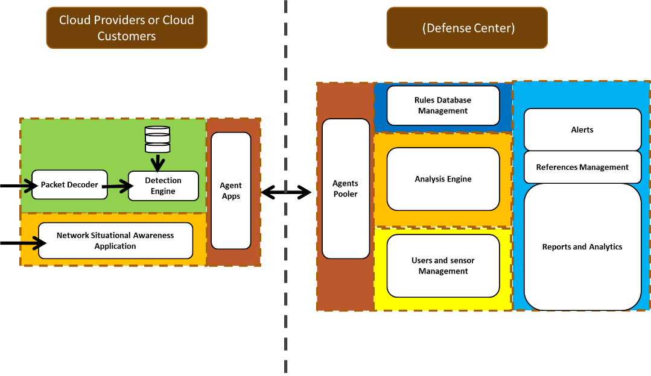
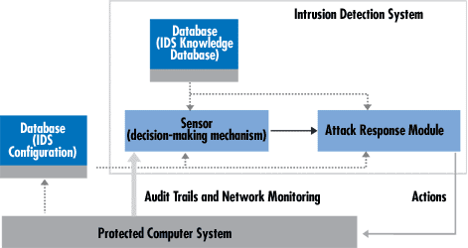
SYSTEM ARCHITECTURE DIAGRAM
Common IDS
Will be built
Notes:
The common IDS architecture is just plain IDS sensor with detection engine with decision making mechanism and simple response all in one place and one network with the system that its protect
The one that will be built is separated between sensor and the defense center. Sensor can be deployed away from the defense center. Sensor can be placed anywhere as long as it’s connected to the internet.
Data that collected by the sensor will be sent to the defense center through the internet
And defense center will process and analyze the data, and it’ll give the alert to corresponding system that there’s attack that going on at that time
Defense center also store the data log to be processed and reported later

Slide 12
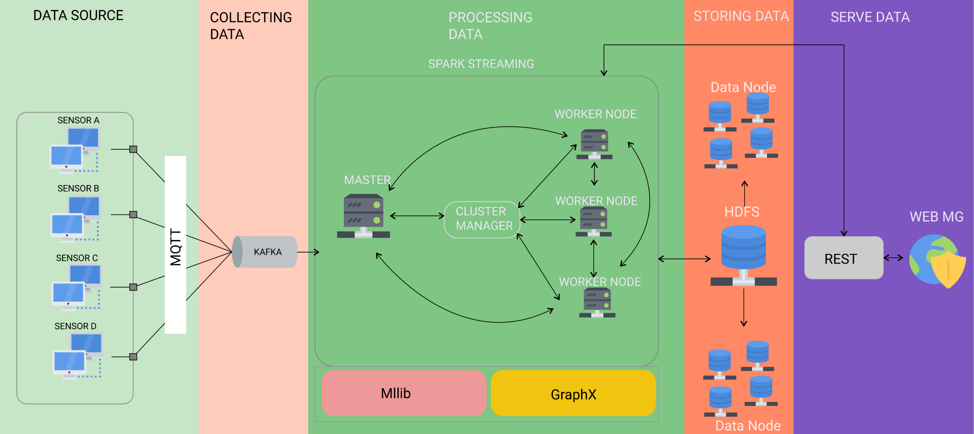
TOPOLOGY(1)
Notes:
The system topolgy consist of five stages, data source management and configuration, data collecting mechanism, data processing, data storing and data serving

Slide 13
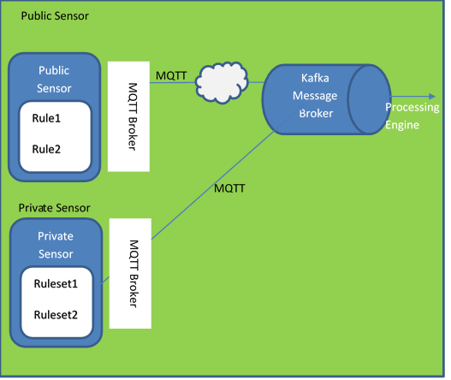
TOPOLOGY(2) – Data Source
Data source in form of event log come from private sensor and public sensor
Delivered using MQTT protocol that channeled data to apache kafka messaging broker system
MQTT is a machine-to-machine messaging protocol that often used by the IoT device, it provide secure, lightweight, publish/subscribe and near-real-time messaging system
The transported data can be secured using SSL and authentication
Notes:
Data source can be set both by public and private network
Snort MQTT will be used to transfer the log data to another message broker system
Why MQTT ? (Baca poin 3)
And of course the security is first priority, the data log can be secured using SSL and user authentication

Slide 14
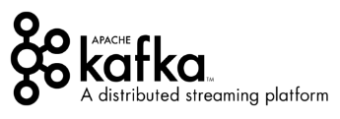
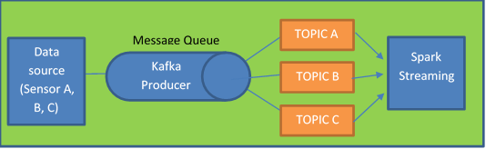
TOPOLOGY(3) – Collecting Data
Apache kafka is distributed message broker system pipeline that can provide stream data messaging system, fast and scalabe
Apache kafka used to received and collect all the data from the sensor using publish and subscribe method
Each sensor will have identifier that will be named as a topic so that kafka can distribute and transport it to corresponding receiver
In this solution, the receiver is apache spark core engine
Notes:
Why kafka ? It has fully integration to the spark core engine, it also has stream capabilities

Slide 15

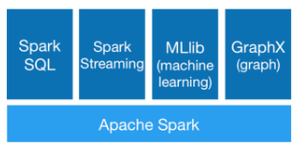
TOPOLOGY(4) – Data Processing & Storing
Apache spark is data processing engine that allow worker to execute streaming, machine learning or SQL
Apache spark wll be built with amount of worker node and will do the data storing and analytical works as a stream process
Analytical works done with spark Mllib and Graphx
Data stored in HDFS (Hadoop Distributed file system)
SQL can be done with built in spark SQL
Notes:
Poin 2, There are three task that’ll be done by apache spark

Slide 16

TOPOLOGY(5) – Data Processing & Storing
HDFS (Hadoop distribution file system) itself is distributed file system designed to run on commodity hardware
It can be works well with apache spark and it’s highly scalable
Notes:
Poin ke 2 – Why HDFS ?

Slide 17
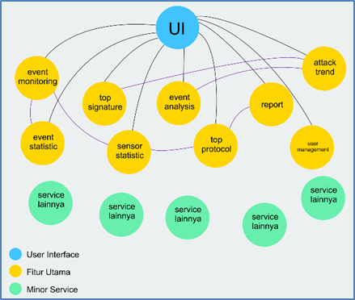
TOPOLOGY(6) – Data Serving
Data serving will be done with microservices API
Microservices is easier to manage, scale, and develop
In the end will be created two product,
Service RESTful API
Precreated web apps user interface to show the metric of the system
The metric are, event monitoring, event statistic, top signature, top protocols, sensor statistic, daily-monthly-annualy report, attack trend, event analysis, and user-role-profile-menu management
The request will be created to apache spark core engine using spark SQL
Big Picture
Notes:
Dari poin ke 2 – Why ?
Poin ke 3, Service can be used to build another apps easily according to API that provided, so it means a lot of posibility can be done with microservices, and yet, in addition to the REST API, the precreated web apps user interface also will be created
As we can see before in the bigger picture before, that there is arrow that direct REST API to the apache core engine, it’s the query that can be done using spark SQL

Slide 18
CONTRIBUTION
The contribution of this research is to help Mata Garuda to adapt and scale its size along side with the growth of data size and cloud computing environment

Slide 19
OLD TITLE & THE NEW ONE
IMPLEMENTATION OF APACHE SPARK STREAM CLUSTERING FOR EVENT LOG ANALYSIS ON MATA GARUDA APPLICATIONS
DESIGN & IMPLEMENTATION OF BIG DATA ON SNORT-BASED CLOUD-IDS

Slide 20
ROADMAP
Pre
- Source data configuration
- Message broker integration
- Core engine installation & integration with message broker
- Data storage design mechanism
1st Progress
- User interface creation
- Service REST API creation
Final
- Analytic modul creation
- Apps created with microservice API
Notes:
Microservice harus selesai pada saat progress 1 UI harus sudah ada, untuk final aplikasi yang dibuat menggunakan API yang sudah dibuat

Slide 21
REFERENCE
K. Vieira, A. Schulter, C. B. Westphall and C. M. Westphall, "Intrusion Detection for Grid and Cloud Computing," IT Professional, vol. 12, no. 4, pp. 38-43, 2010.
H. Debar, M. Dacier and A. Wespi, "Towards a taxonomy of intrusion-detection systems," Computer Networks, vol. 31, no. 8, pp. 805-822, 1999.
G. I. Wowilling, F. A. Saputra and I. U. Nadhori, Rancang Bangun Aplikasi Mata Garuda untuk Monitoring IDS Berbasis Snort, Surabaya: Politeknik Elektronika Negeri Surabaya, 2014.
S. Irdoni, F. A. Saputra and A. S. Ahsan, Optimasi Desain Database Mata Garuda dengan Menerapkan Partition Table, Surabaya: Politeknik Elektronika Negeri Surabaya, 2017.
M. Hisyam, F. A. Saputra and J. A. Nur Hasyim, IDS Log Analisis Menggunakan Hadoop dan Mahout untuk Data Mining Pada Mata Garuda, Surabaya: Politeknik Elektronika Negeri Surabaya, 2015.
W. L. Al-Yaseen, Z. A. Othman and M. Z. Ahmad Nazri, "Real-Time Intrusion Detection System Using Multi-agent System," IAENG International Journal of Computer Science, pp. 1-11, 2016.
A. L. Severien, "Scalable Distributed Real-Time Clustering for Big Data Streams," p. 2013, 25 June 2013.

